Slide 1

Project Title: Bingo for Senior Citizens Requirement Analysis
Md Rezaul Hoque
200484979

Slide 2
Problem Statement
Senior Center Without Walls Saskatchewan is a nonprofit program looking to develop a bingo game for senior citizens that can be played from home using dial pad phones without any visuals.
Target Community: Senior citizens of Saskatchewan, particularly those with limited mobility.

Slide 3
Project Stakeholders
Name | Project Role | Power | Interest | Level of Support
Ronda - [SCWW] | Customer | High | High | Supportive
Jack Hadley - [SCWW] | Customer | Low | High | Supportive
Timothy Maciag | Supervisor | High | High | Supportive
Md Rezaul Hoque | Project Manager/Developer | High | High | Supportive
Saskatchewan Liquor and Gaming Authority (SLGA) | Regulatory Body | High | Neutral | Neutral

Slide 4


Business Case
Business Need:
Develop a bingo game for senior citizens to play from home using dial pad phones/landline.
The goal is to raise funds from this game for charity programs.
Cost-Benefit Analysis:
Enhance social interaction and mental stimulation for seniors
Reducing feelings of isolation and loneliness
Leverage the community participation in raising fund for charity
Potential Risks:
Regulations by the Saskatchewan Liquor and Gaming Authority (SLGA).
Squeezed timeline from ideation to MVP development, testing, and go-live.

Slide 5
Current Technology Configuration
Platform: Dialpad
Supported Activities: Conference calls
Tool: Conference call dial-in
Key Features:
Telephone-based conference call
Multiple participants
No advance scheduling needed
Toll-free access for participants

Slide 6
Community Characteristics & Orientation
Name: Senior Center Without Wall Saskatchewan Community
Objective: Guide in finalizing functional requirements.
Current State
Life-Cycle: Just forming.
Initiative: Develop a Bingo game for senior citizens.
Constitution
Diversity: SCWW Management body, senior citizens.
Participation: Synchronous participation within Saskatchewan, English-speaking.
Technology Aspirations
Interest: Low interest in technology.
Skills: Limited capacity and tolerance for new tools.
Community Orientation
Meetings: real-time interaction over phone.
Notes:
Life-Cycle: They are exploring new ideas to connect and collaboration

Slide 7
Current State vs. New Innovations
Community Characteristics:
Target Audience: +55 aged people within Saskatchewan, mostly not tech-savvy.
Current Tools: Basic dial pad phone and landline.
Goal: Utilize existing tools to facilitate community engagement.
New Configuration: Integrate the Dialpad application for playing bingo.
Challenges: Regulatory concerns from SLGA regarding remote bingo gaming.
Constraints: High availability, accuracy, and real-time interaction required.
Community Skills: Limited technological skills.

Slide 8
Functional Requirements
User and Access Management (MVP-3):
Secure password management and user authentication.
Role-based access (Administrator, Bingo Card Generator, Bingo Caller).
Bingo Card Generation (MVP-1):
Generate unique bingo cards with serial numbers.
Download cards in PDF format.
Register cards with player's name.
Set expiration dates for cards.
Win Detection (MVP-2):
Detect winning patterns (row, column, diagonal).
Immediate win notification.
Manual verification by serial number.
Block claimed cards to prevent reuse.

Slide 9
Logical/Block diagram
User
User Authentication and Access Management
Bingo Card Generation
- Generate Unique Cards
- Download Cards (PDF)
- Register Cards (Player Info)
- Set card expiration
Win Detection
-Detect Winning Patterns
-Notify Bingo Caller
-Manual Verification
-Block bingo claimed card
Database
(SQLite - Data Storage)

Slide 10

Technical/Performance Requirements
System Architecture:
The final solution has 2 main tools
Bingo Card Generation tool
Game management/Win detection tool
Infrastructure/Technology stack:
Install the application on local machines (PC/laptop).
Use SQLite for local data storage.
Implement with JavaScript/Django
Performance
Handle up to 10 concurrent users.
Ensure 99.9% uptime.
Ensure 2-second response time.
Security
Data Encryption
User Authentication
Accuracy
100 % Win Detection Accuracy
Unique Serial Numbers
Card expiration Management
UI/UX:
Responsive design for desktop, tablet, mobile.
Intuitive navigation.
User-friendly interface.
Compliance:
Adhere to SLGA guidelines.

Slide 11
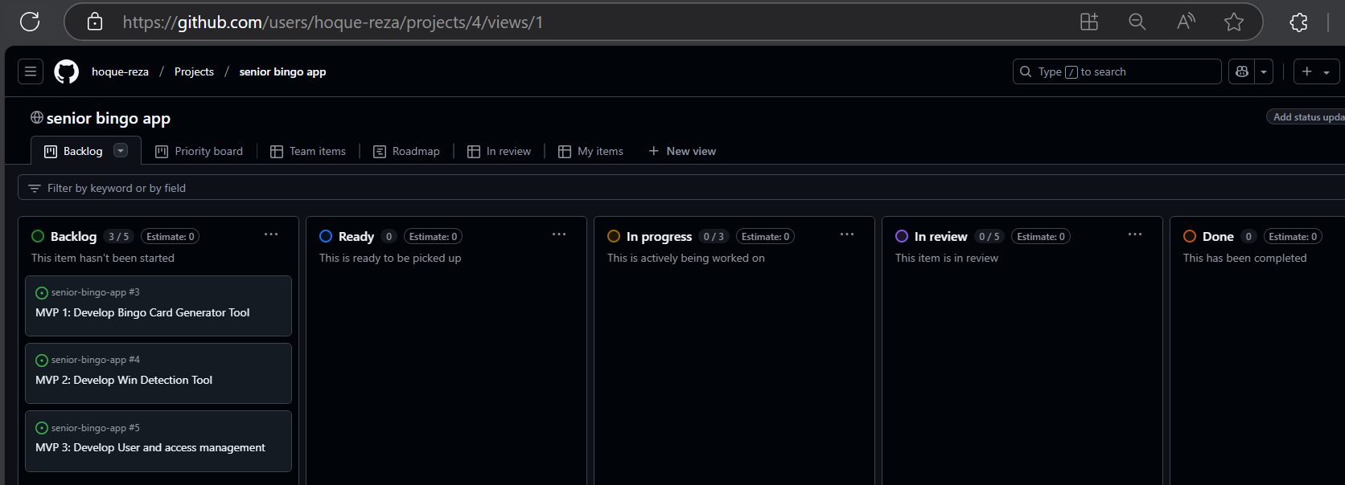
GitHub project board (Kanban board)

Slide 12
Low fidelity Prototype

Slide 13
Thanks
Any Question?

